Slide 1


SUPPLY CHAIN LOGISTICS NETWORK AND DELIVERY PERFORMANCE VISUALIZATION PLATFORM
DSA0601 – DATAHANDLING AND VISUALIZATION
Presented by: K.SAISOMASEKHAR REDDY(192324134)
K.KIRAN(192324205)
C.REVI THIMMA REDDY(192325025)
Guided By :
Dr. S.SENTHILVADIVU

Slide 2


ABSTRACT
The Supply Chain Logistics Network and Delivery Performance Visualization Platform is designed to monitor and analyze the complete movement of goods from suppliers to customers.
The system collects and integrates logistics data such as shipment status, delivery time, transportation routes, order details, and warehouse information.
It provides interactive dashboards and visualizations to track key performance indicators such as on-time delivery rate, delays, transportation efficiency, and order fulfillment.
The platform helps identify delivery delays, inefficient routes, bottlenecks, and high-risk logistics areas, enabling organizations to make data-driven decisions.
Overall, the system improves supply chain visibility, operational efficiency, delivery performance, and customer satisfaction through real-time monitoring and analytics.

Slide 3
INTRODUCTION
Supply chain logistics involves the movement of goods from suppliers to customers through various transportation and storage stages.
Efficient logistics management is essential for reducing delivery delays, transportation costs, and operational problems.
The proposed platform uses data visualization and analytics to monitor supply chain activities and delivery performance.
Interactive dashboards help users easily understand orders, shipment status, delivery times, routes, and delays.

Slide 4
LITERATURE SURVEY
AUTHOR NAME | YEAR OF PUBLISHED | TITLE OF THE PAPER | ABOUT
H. Min et al. | 2023 | Supply Chain Management and Logistics: A Review | Explains modern supply chain management and the importance of efficient logistics and transportation.
S. Chopra et al. | 2024 | Data Analytics in Supply Chain Management | Uses data analytics to monitor supply chain activities and improve operational decision-making.
P. Raj et al. | 2025 | Data Visualization for Supply Chain Performance Analysis | Uses interactive dashboards and visualization techniques to analyze delivery performance and identify logistics problems.

Slide 5
OBJECTIVES
To monitor the supply chain and logistics network efficiently and maintain better visibility of transportation and delivery activities.
To track shipment and delivery status from dispatch to the final destination and ensure timely delivery of products.
To visualize delivery performance using dashboards and charts for easy understanding and analysis of logistics data.
To identify delays, bottlenecks, and inefficient routes and take suitable actions to improve transportation efficiency.

Slide 6
MODULES
Logistics Data Integration & Route Mapping Module
Delivery Time Distribution & On-Time Performance Module
Supply Network Association & Bottleneck Visualization Module

Slide 7
Module-1: Logistics Data Integration & Route Mapping Module
Collects shipment, vehicle, warehouse, and customer data in one centralized platform for easy monitoring and analysis.
Integrates logistics data from multiple sources to provide complete and accurate supply chain information.
Displays source, destination, and delivery routes clearly using interactive maps.
Helps identify shortest and efficient routes to reduce travel distance and delivery time.
Monitors shipment and vehicle locations during transportation for better visibility.

Slide 8
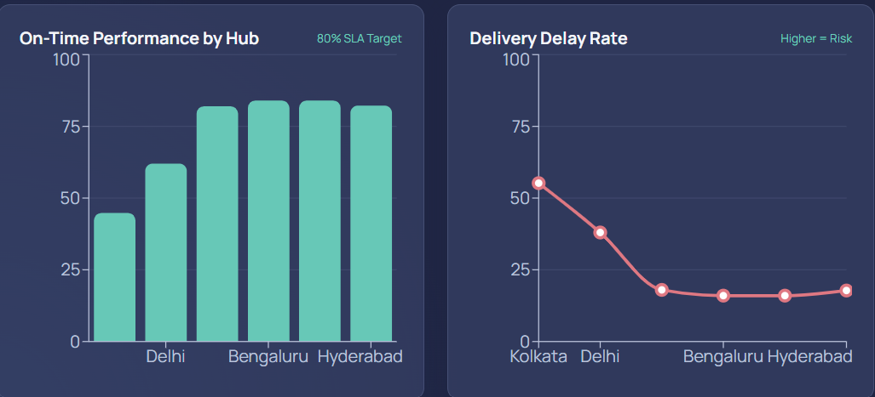
OUTPUT

Slide 9
Module-2: Delivery Time Distribution & On-Time Performance Module
Records and compares planned and actual delivery times for every shipment.
Classifies deliveries as early, on-time, or delayed for easy performance analysis.
Calculates the on-time delivery percentage to measure delivery efficiency.
Uses charts and graphs to clearly display delivery time and performance data.
Identifies frequent delays and delivery patterns across different shipments and routes.
Supports better delivery planning and scheduling to improve customer satisfaction.

Slide 10
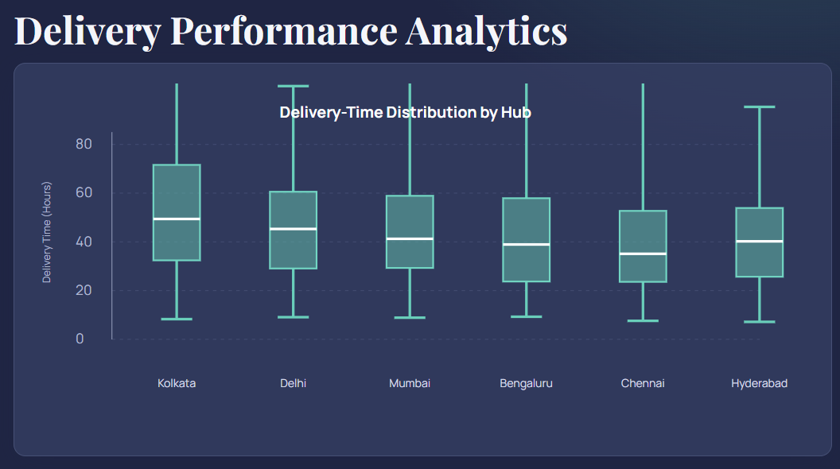
OUTPUT

Slide 11
Module-3 Supply Network Association & Bottleneck Visualization Module
Shows connections between suppliers, warehouses, transport points, and customers in the supply network.
Provides a clear visualization of the complete flow of goods across different locations.
Identifies bottlenecks and slow-moving points that affect supply chain performance.
Detects locations responsible for delays, congestion, and operational problems.
Uses network diagrams and visual charts to make complex supply relationships easier to understand.

Slide 12
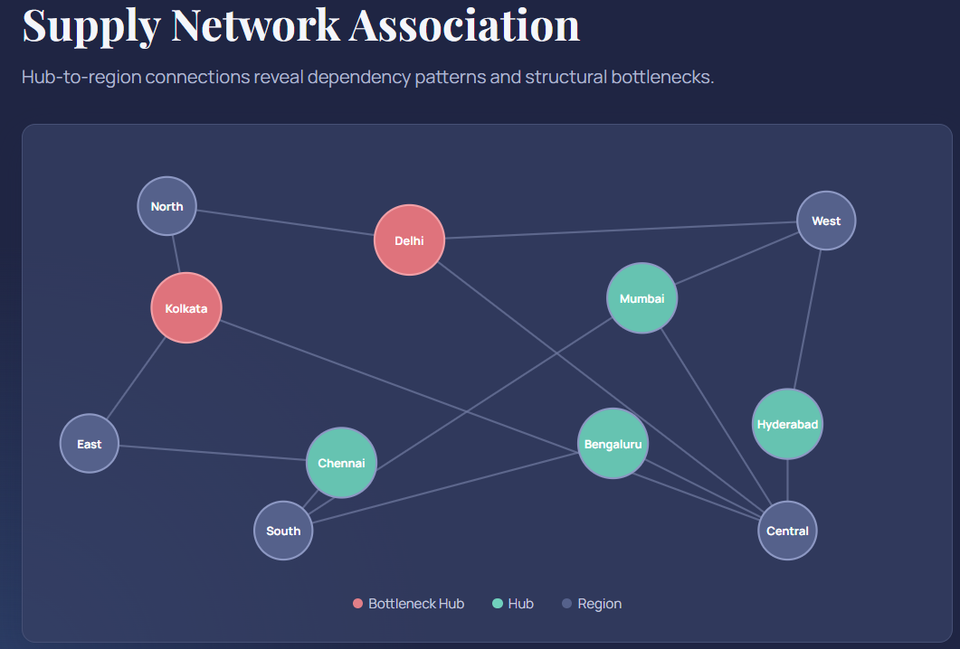
OUTPUT

Slide 13
FUTURE SCOPE
Integration of AI and Machine Learning can help predict delivery times, identify possible delays, and improve logistics planning.
Use of IoT and GPS technology can provide real-time shipment tracking and accurate information about vehicle and product locations.
Development of mobile applications can allow managers, delivery staff, and customers to access shipment information easily from anywhere.
Addition of automated alerts can notify users about shipment delays, route changes, and other important delivery issues.

Slide 14
CONCLUSION
The platform provides better visibility of supply chain operations by bringing important logistics and delivery information into one system.
It helps monitor shipment and delivery performance and allows users to track the progress of products throughout the delivery process.
Visual dashboards and charts make complex logistics data easier to understand and help users analyze important performance information.
Overall, the platform improves efficiency, decision-making, and delivery performance while supporting better service and customer satisfaction.

Slide 15
REFERENCES
Tang, Y. & Zha, C. (2026) – Application of Internet of Things (IoT) and Machine Learning (ML) in Intelligent Logistics Supply Chain. Discover Internet of Things.
Wang, J., Lim, M. K. & Liu, W. (2024) – Promoting Intelligent IoT-Driven Logistics Through Integrating Dynamic Demand and Sustainable Logistics Operations. Transportation Research Part E: Logistics and Transportation Review.
Xie, L., Liu, J. & Wang, W. (2024) – Predicting Sales and Cross-Border E-Commerce Supply Chain Management Using Artificial Neural Networks and the Capuchin Search Algorithm. Scientific Reports, 14, 13297.

Slide 16
THANK YOU !

